Slide 1



IT3501-Full Stack Web Development
Mini Project
Student Result Management System
Technologies Used: Angular, Express.js, MongoDB
Developed By:
Kirran S T (953623205025)
Harish Krishnan P (953623205018)
Balashankar R (953623205006)

Slide 2

INTRODUCTION
A web-based full stack application developed using the MEAN stack (MongoDB, Express.js, Angular, and Node.js)
To automate the academic result management process in educational institutions.
Students can log in to view their results while faculty can update result.
Update, and manage student marks efficiently. This system ensures accuracy, transparency, and real-time access.
01

Slide 3
OBJECTIVES
• Login for students and staff
• Support real-time result updates
• Reduce manual errors and paperwork
• Improve accessibility and transparency in result publication
02

Slide 4
EXISTING SYSTEM
• Manual or semi-digital systems using paper or Excel sheets
• Time-consuming and error-prone result calculation
• Data duplication and loss possible
• Lack of real-time updates
03

Slide 5
PROPOSED SYSTEM
• Web-based MEAN stack application
• Centralized MongoDB database for storing student and result data
• Login for students and administrators
• Online result viewing
04

Slide 6
SYSTEM ARCHITECTURE
Frontend: Angular for user interface
Backend: Node.js and Express.js for logic and APIs
Database: MongoDB for result and user data
Architecture: Client-Server model using RESTful APIs
05

Slide 7
IMPLEMENTATION AND METHODOLOGY
• Angular – frontend UI
• Node.js & Express.js – backend server and APIs
• MongoDB – database management
• CRUD operations for result management
06

Slide 8
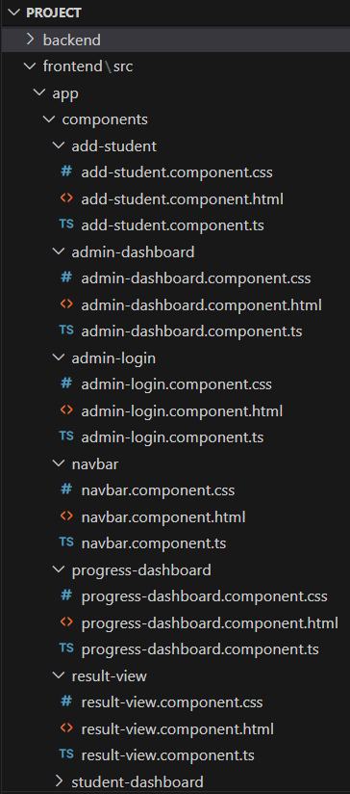
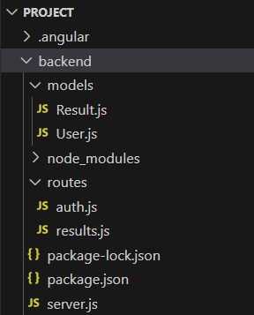
FOLDER STRUCTURE
07

Slide 9
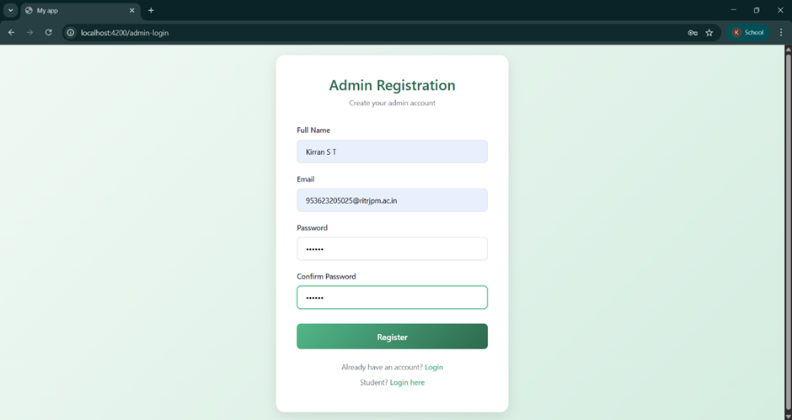
OUTPUTS
08

Slide 10
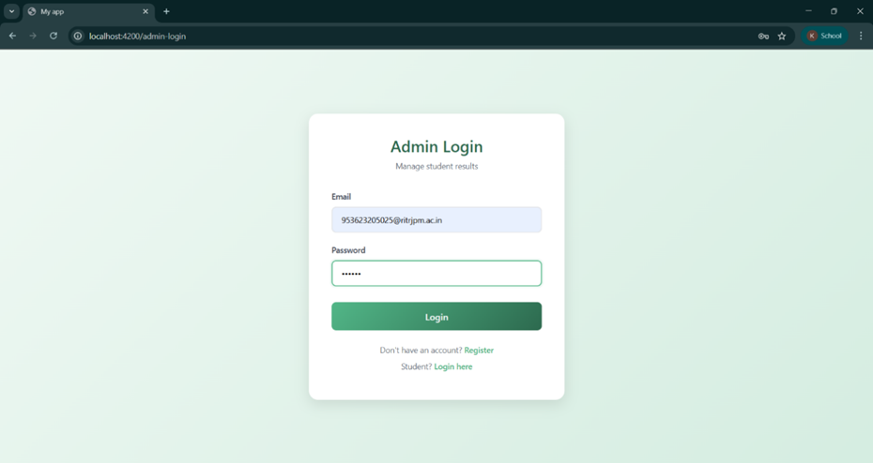
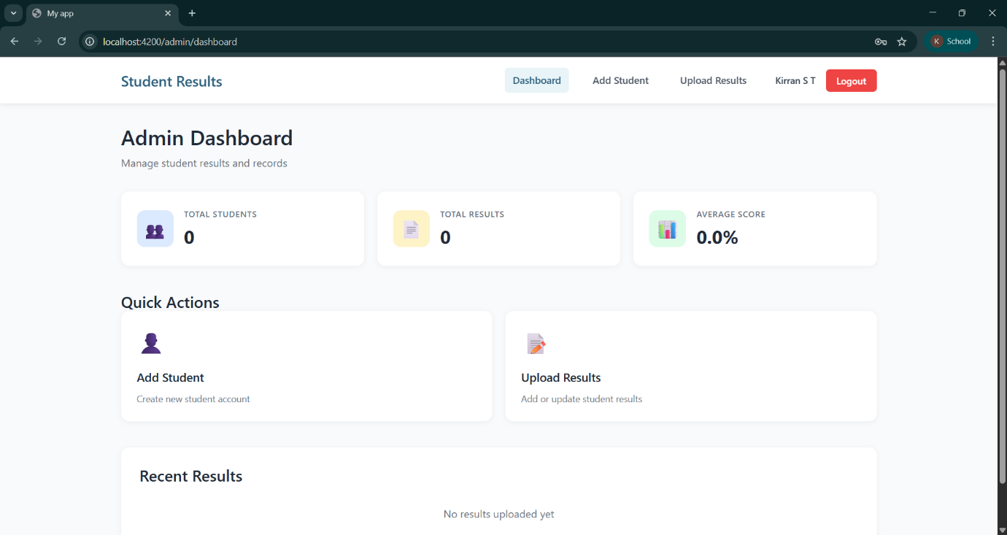
OUTPUTS
09

Slide 11
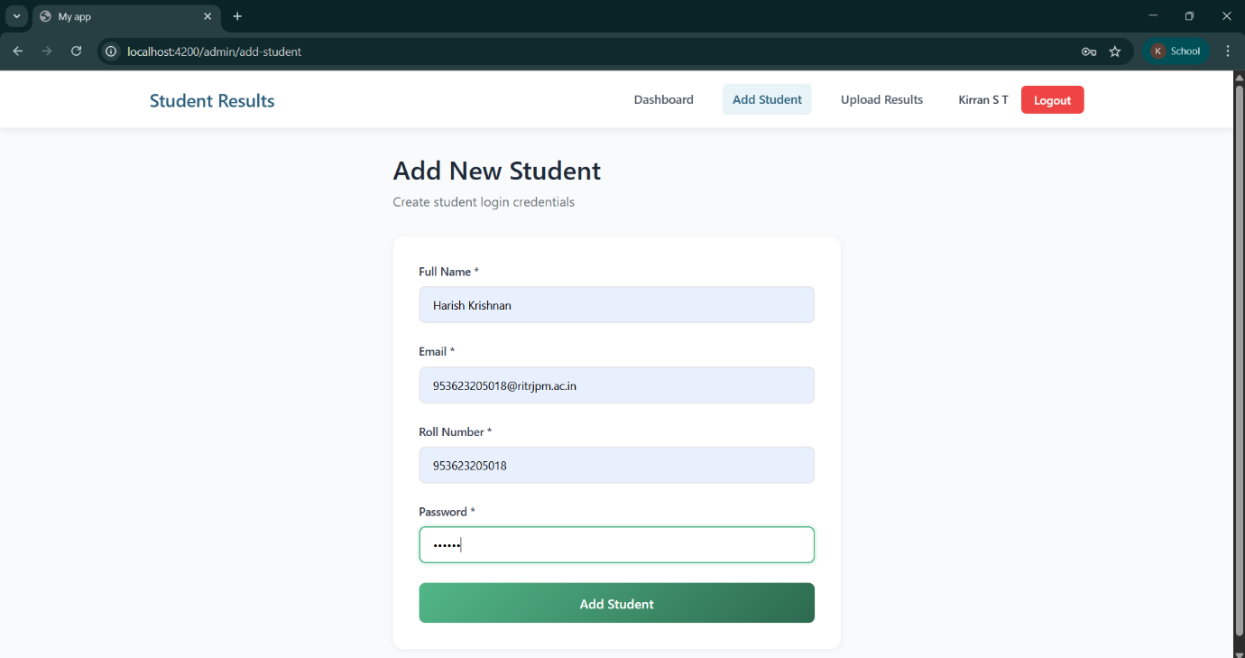
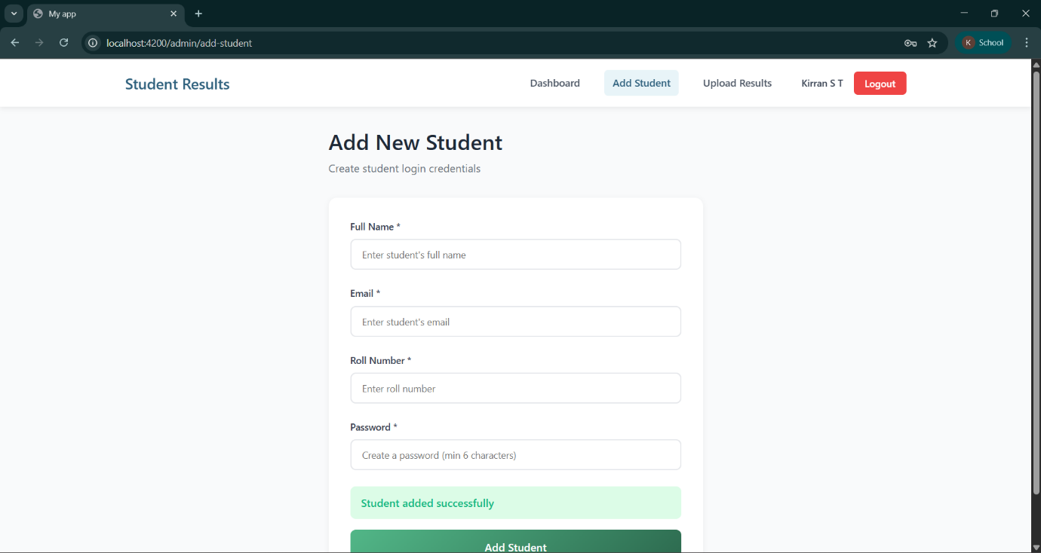
OUTPUTS
10

Slide 12
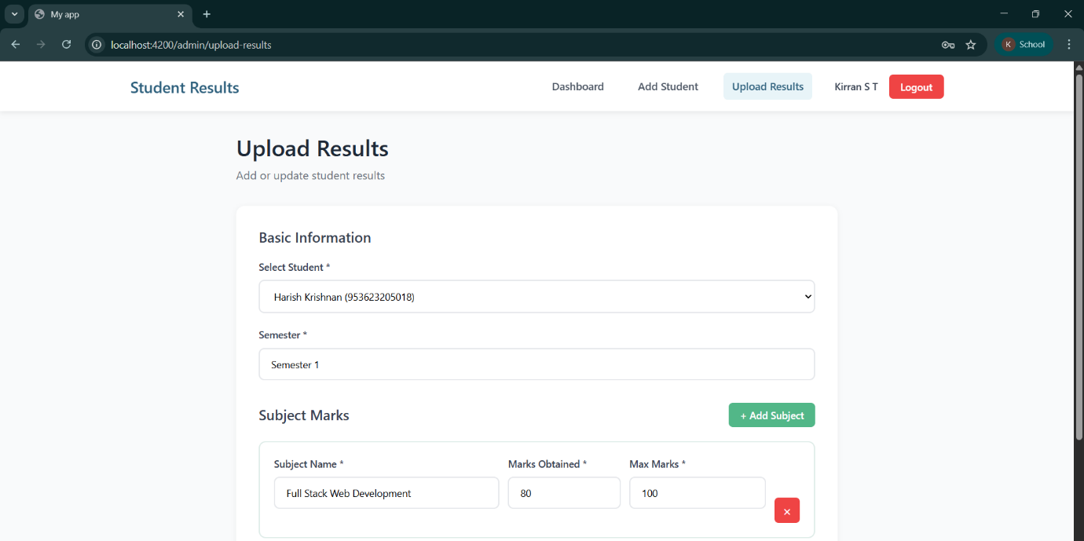
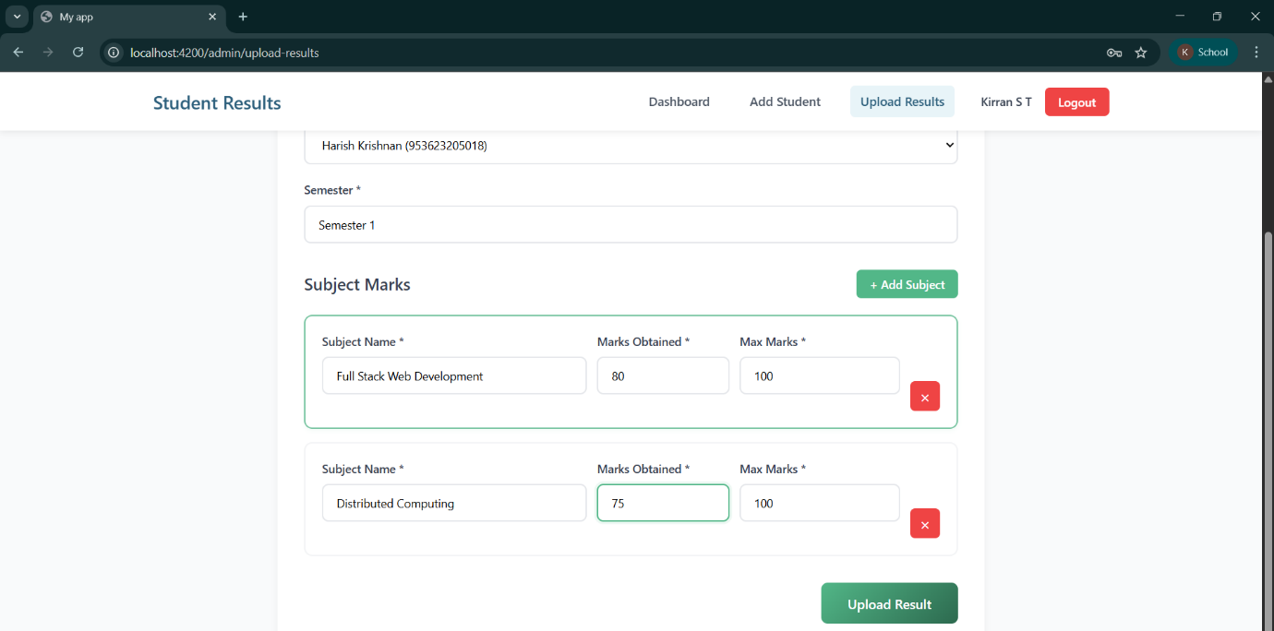
OUTPUTS
11

Slide 13
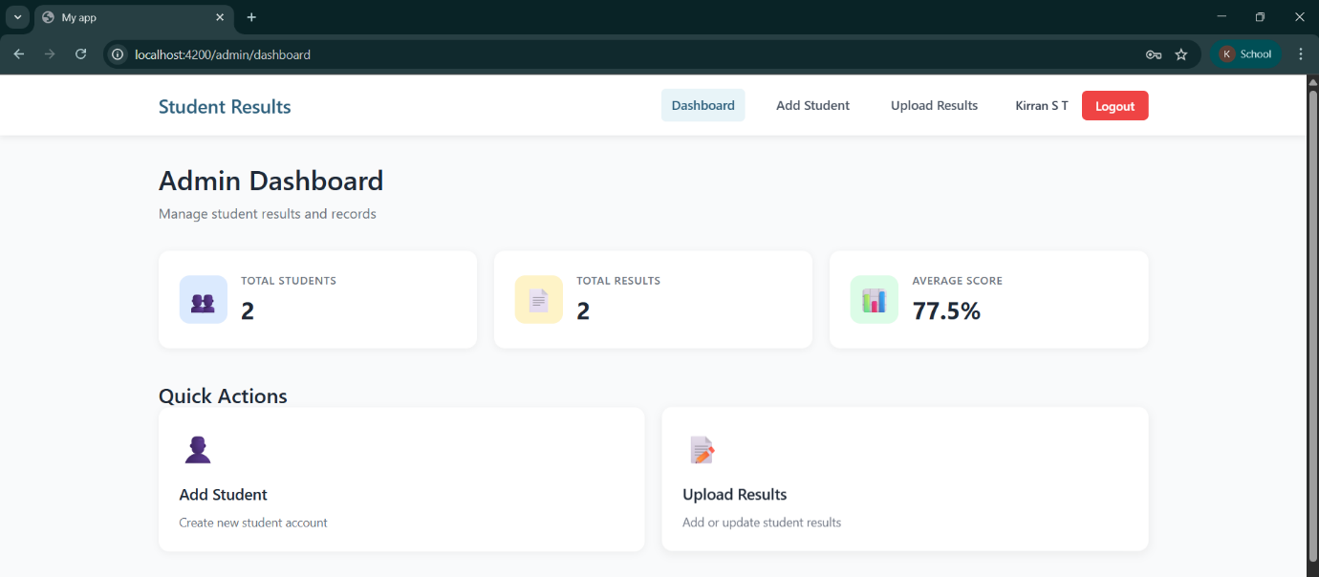
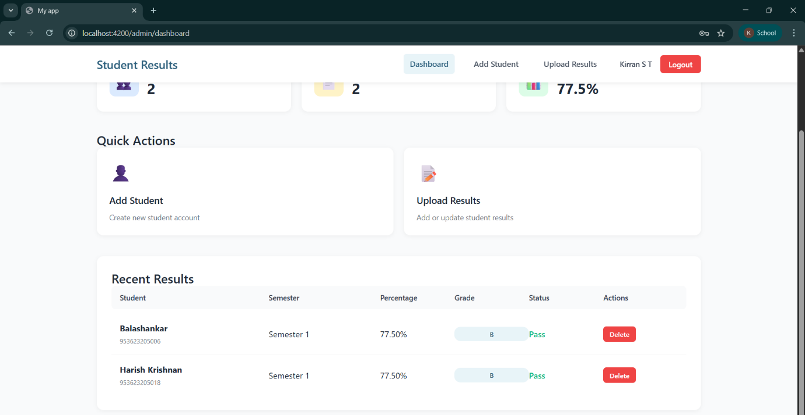
OUTPUTS
12

Slide 14
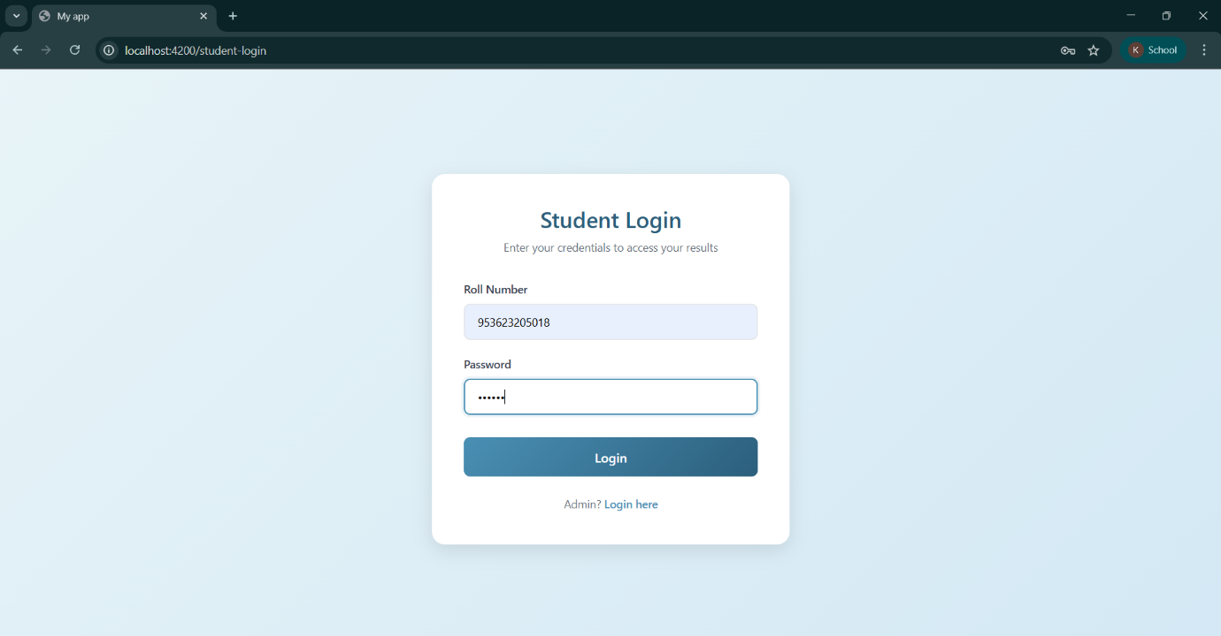
OUTPUTS
13

Slide 15
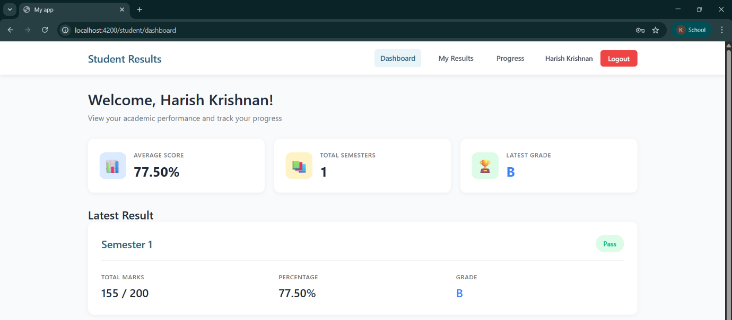
OUTPUTS
14

Slide 16
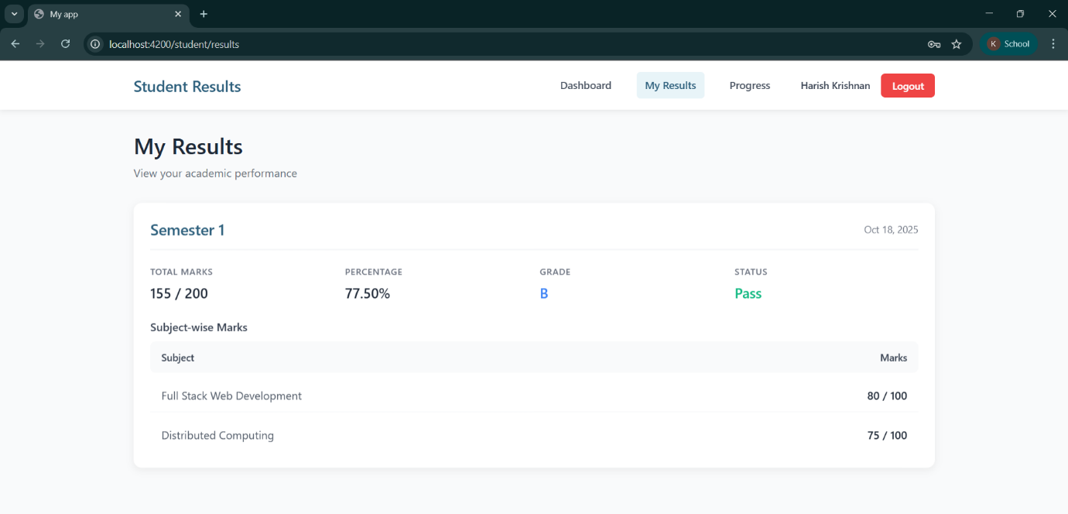
OUTPUTS
15

Slide 17
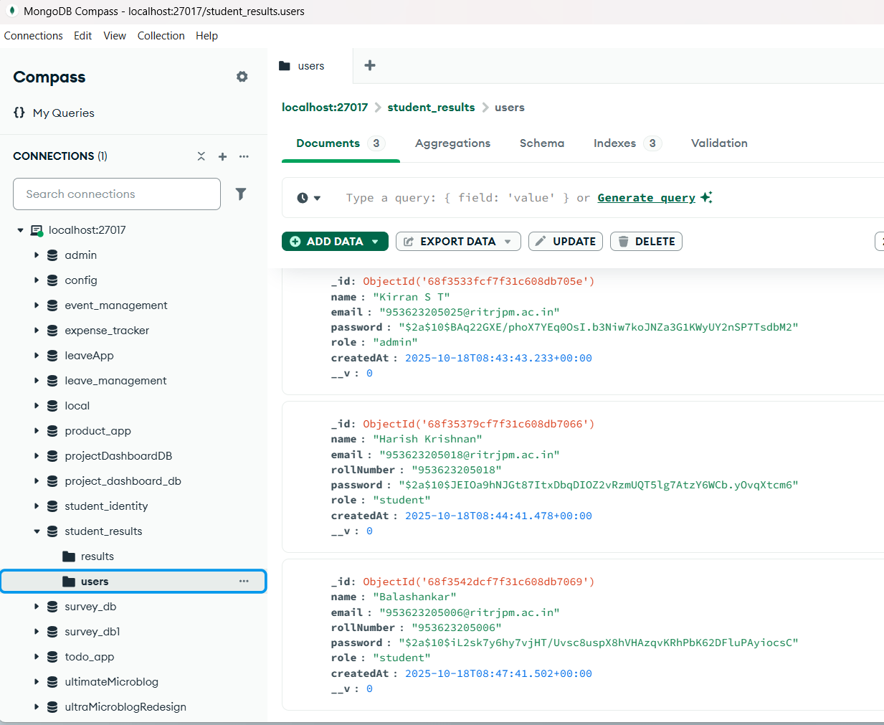
OUTPUTS
16

Slide 18
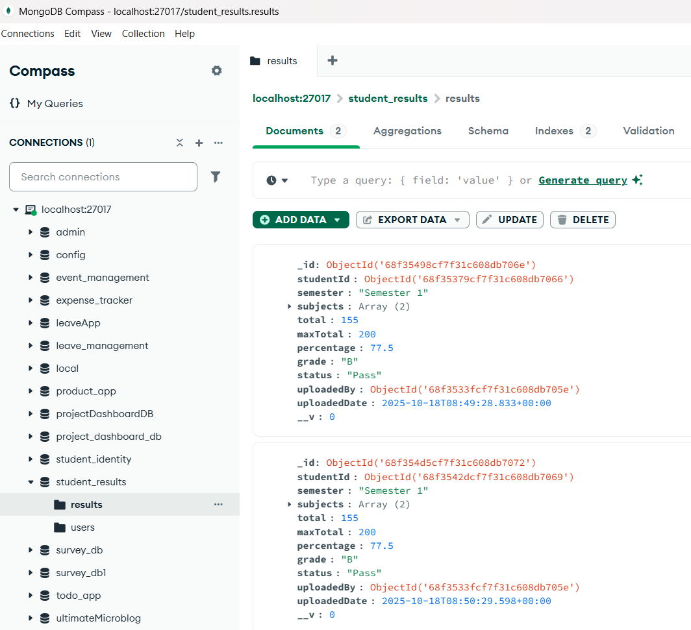
OUTPUTS
17

Slide 19
FUTURE ENHANCEMENT
• Add graphical performance charts
• Provide cloud-based data backup
• Generate downloadable reports (PDF/Excel)
• Integrate AI analytics for student performance trends
18

Slide 20
CONCLUSION
The Student Result Management System successfully digitalizes result handling.
It improves data accuracy, reduces errors, and enhances transparency.
Built using the MEAN stack, it provides a modern, scalable, and efficient solution
19

Slide 21
THANK YOU
20

